Slide 1
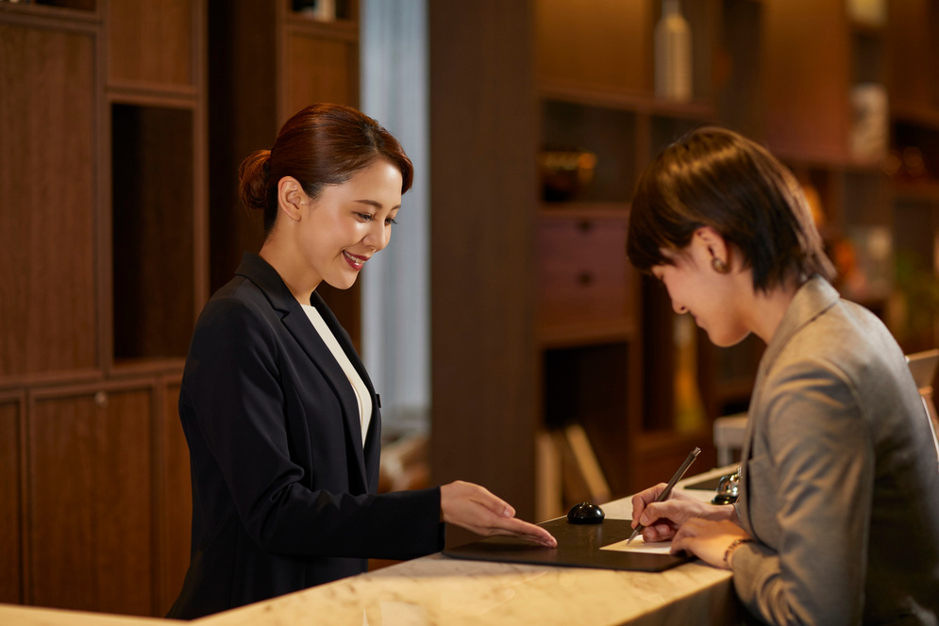

GX Case Study: Insights & Trends
Presented by:
Shreyas Mathews
Date;
July 7th, 2025

Slide 2
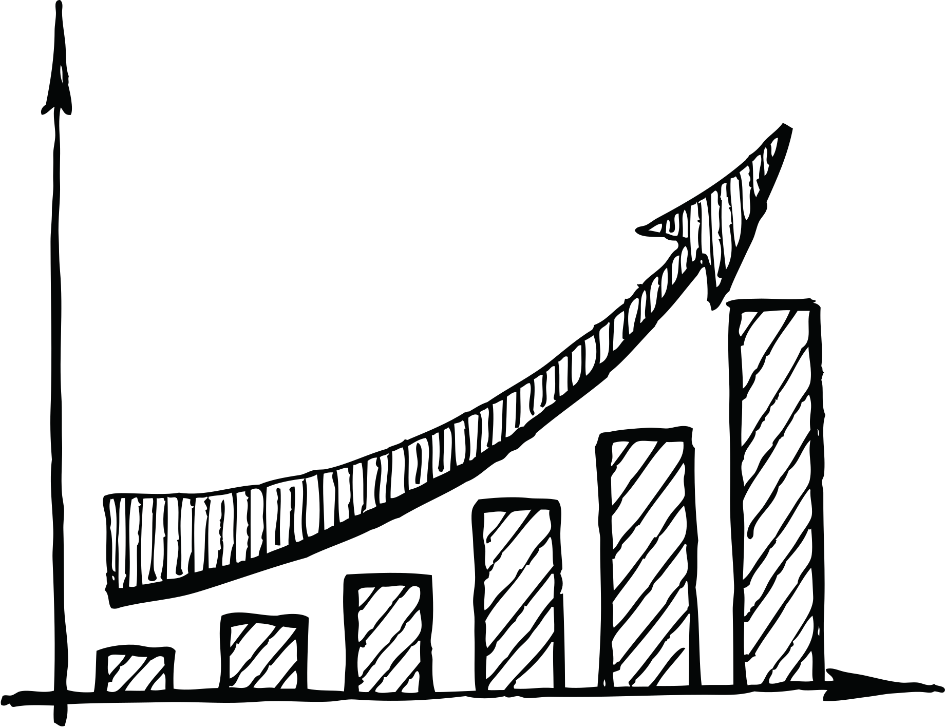
Content
About the Sample Data - Dataset
Analysis on Performance
Analysis on Trends
Analysis into Driving Factors - GX
Key areas to focus and improve NPS
Recommendations
Tools used for Case Study - Analysis
Conclusion

Slide 3
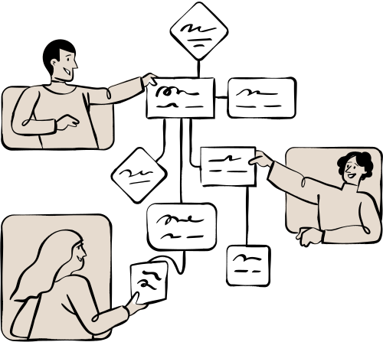
About the Sample Data
Survey Data ranging from 1st Jan 2025 - 30th April 2025
Survey Data - Guest responses (Both Quantitative and Qualitative)
Key Column - “NPS : Recommending Hotel to friend or colleague”?
Quantitative Columns i.e Survey date, NPS Score, ARRIVAL_DATE, DEPARTURE_DATE, NIGHTS.
Qualitative - i.e. Rest of the Feedback Categories / Columns.
Internal Stakeholders Involved

Slide 4

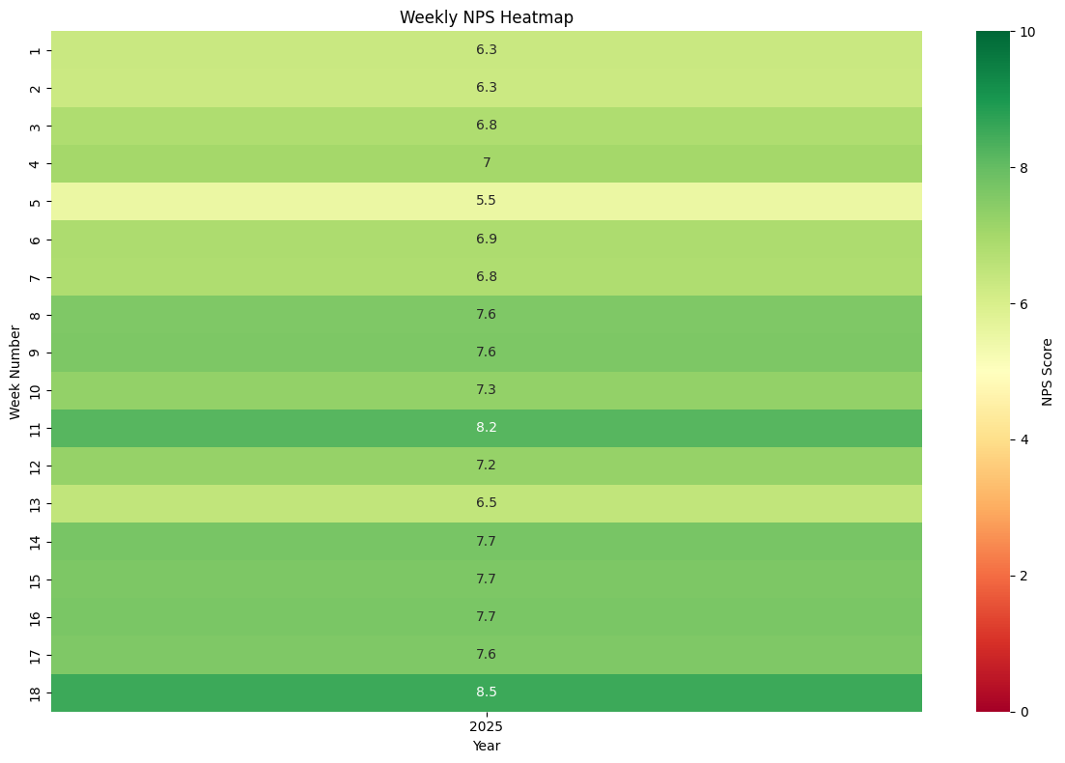
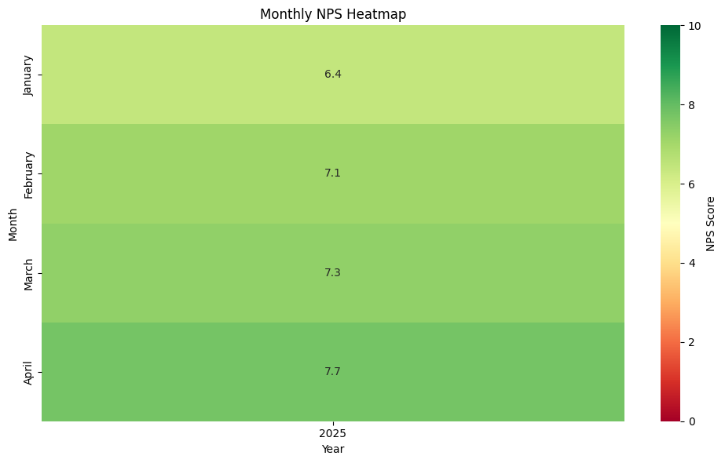
Performance & Trend Analysis
NPS: Based on your recent stay, how likely are you to recommend [Field-HOTEL_NAME] to a friend or colleague?
Average NPS trend across 18 weeks i.e. 4 months
Average NPS trend across 4 month basis

Slide 5
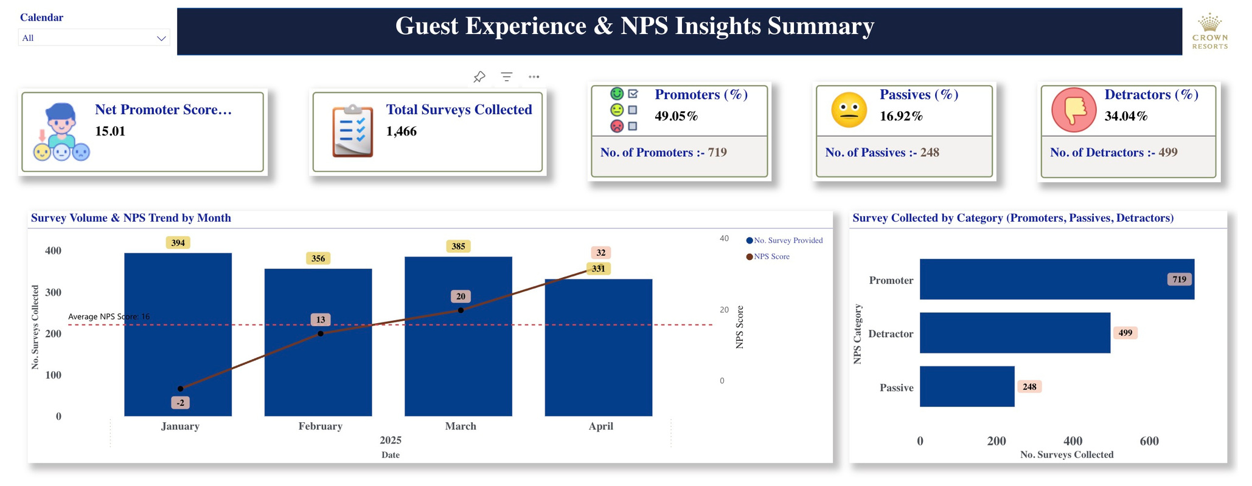
Performance & Trend Analysis
i.e Interactive Dashboard with NPS Trend on Power BI
NPS Score Calculation - Group into Promoters(9-10), Passives(7-8) and Detractors(0-6)
NPS = (%)Promoters - (%) Detractors

Slide 6
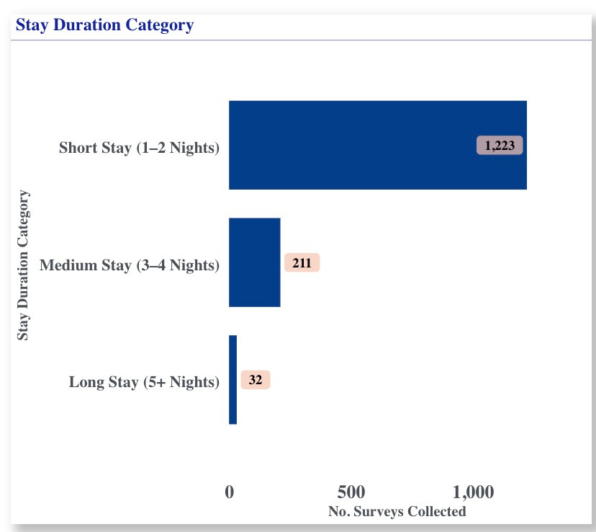
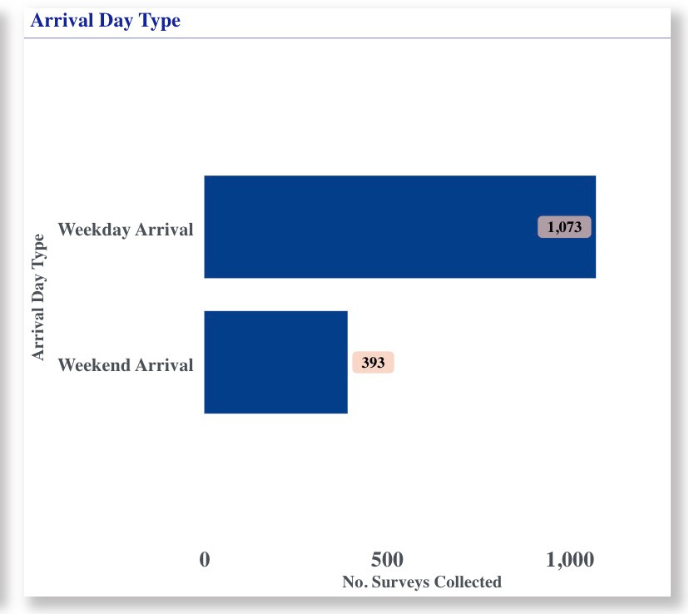
Performance & Trend Analysis
Stay Duration Trend i.e. Days
Weekday Vs Weekend Arrial Trend

Slide 7
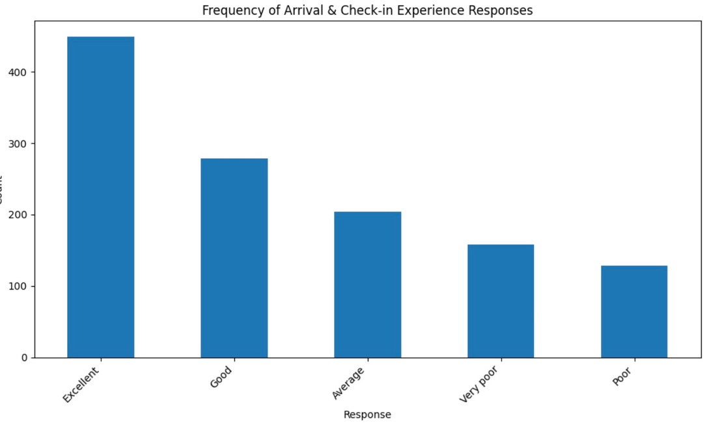
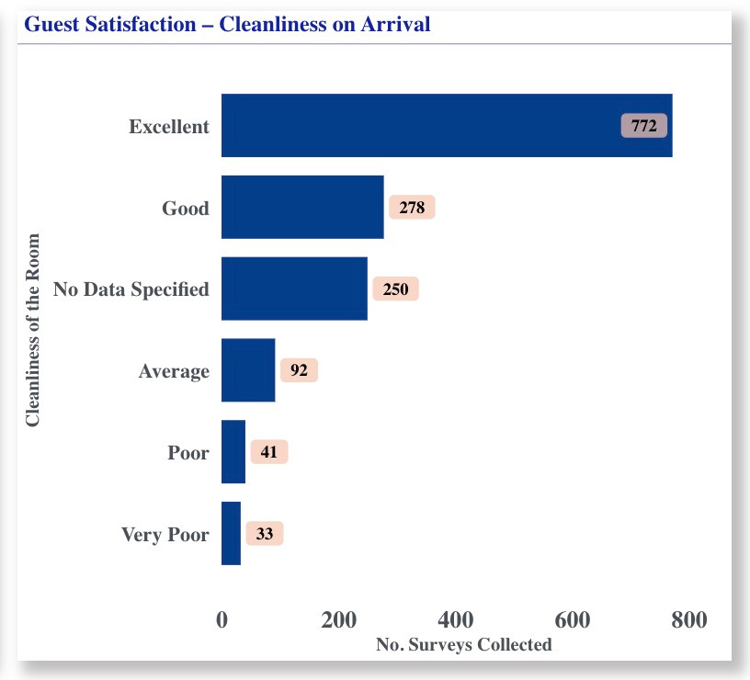
Performance & Trend Analysis
1) "Your arrival & and check-in experience"
2) "The cleanliness of your room upon arrival"
Check-in Experience Responses
Total number of Surveys for Cleanliness of the Room responses.

Slide 8
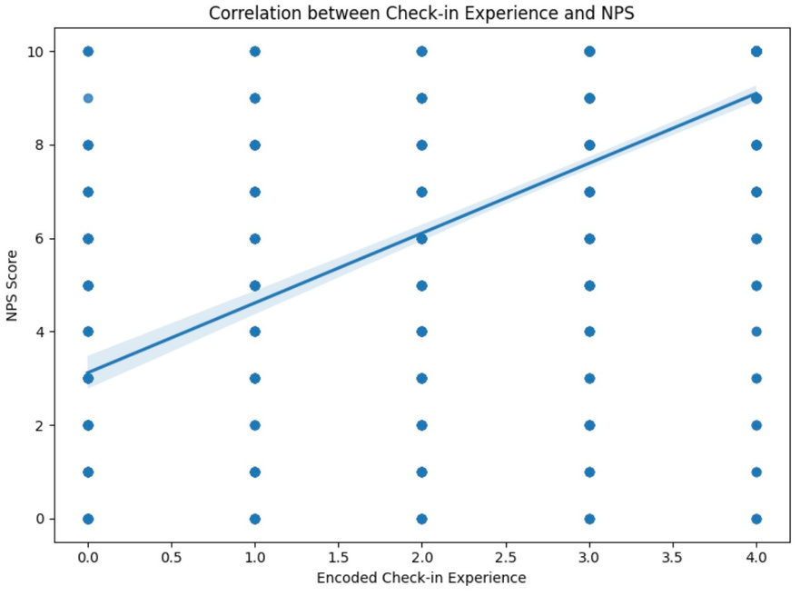
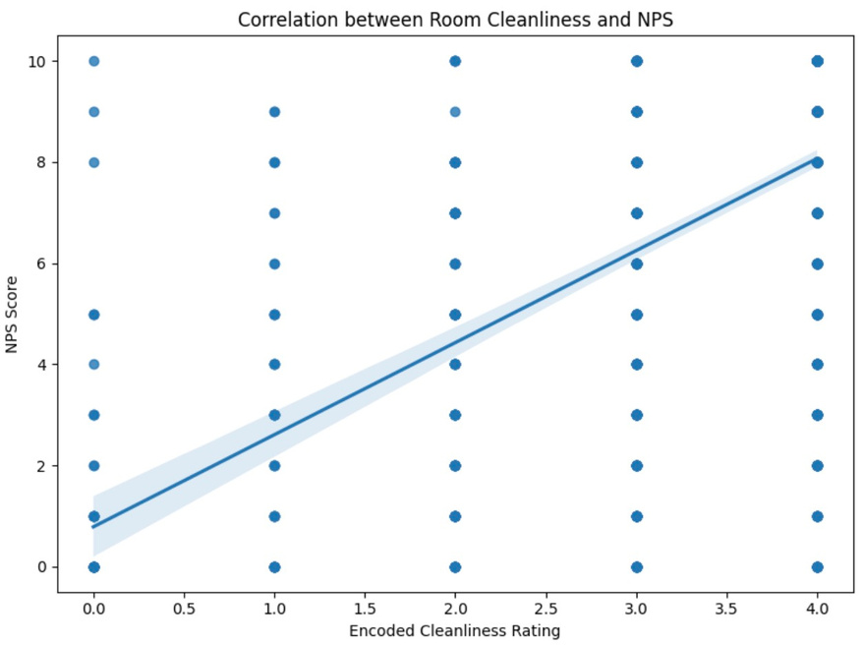
Insights
For "Your arrival & and check-in experience"
Internal Stakeholder - Front Office ( Front Desk + Bell + Concierge)
Correlation can be used to check its effect on NPS. Correlation is a statistical concept to check the strength and linear relationship between 2 variables.
We have to encode the values into numbers before running the Correlation.
checkin_sentiment_map = { "Very poor": 0, "Poor": 1, "Average": 2, "Good": 3, "Excellent": 4}
Correlation coefficient is 0.638 between NPS and check-in experience(encoded) signifies a moderately strong positive relationship.
For "The cleanliness of your room upon arrival"
Internal Stakeholder - Housekeeping Department
Correlation coefficient is 0.532 between NPS and cleanliness(encoded) signifies a moderate positive relationship.

Slide 9
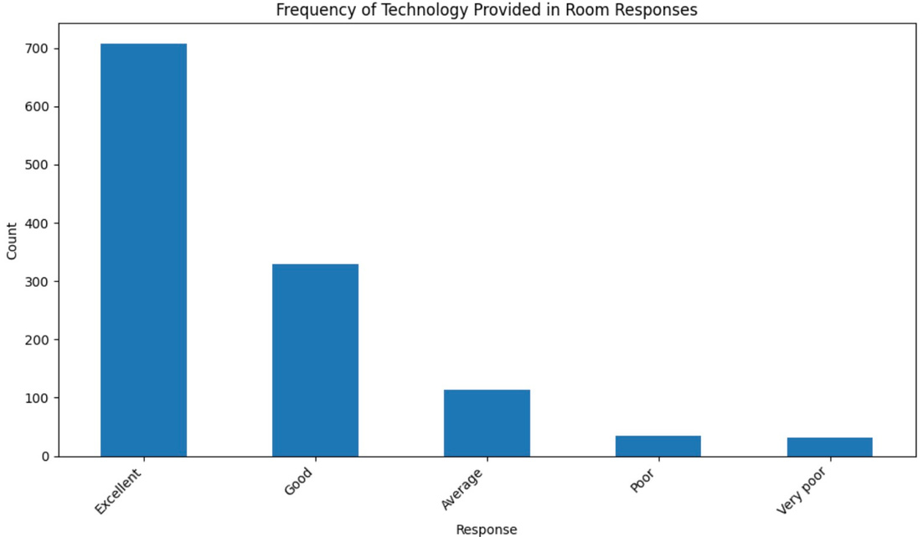
Performance & Trend Analysis
3) "The overall condition of your room"
4) "The technology provided in your room"
Total number of Surveys for Overall Room Condition
Total number of Surveys for Tech Provided in the Room

Slide 10
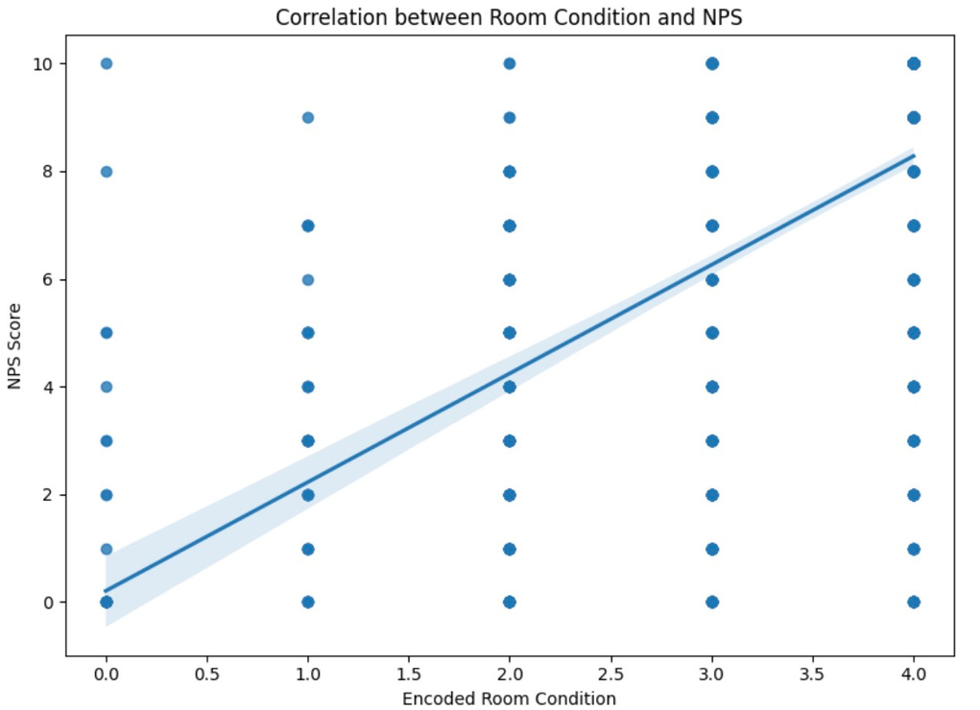
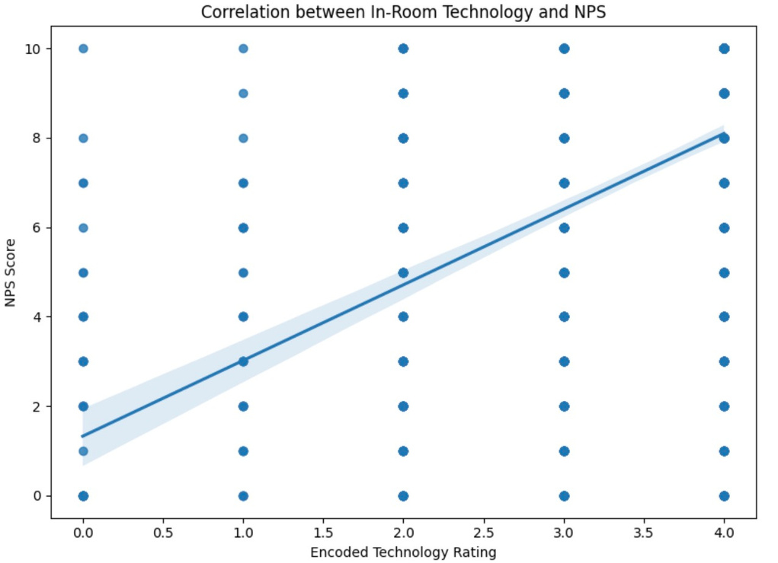
Insights
For "The overall condition of your room"
Internal Stakeholder - (Housekeeping + Property Services + AV Team)
Correlation coefficient is 0.56 between NPS and Room Condition (encoded) signifies a moderate positive relationship.
For "The technology provided in your room"
Internal Stakeholder - (Mainly IT Team + AV Team + Property Services)
Correlation coefficient is 0.488 between NPS and Technology Provided (encoded) signifies a moderate positive relationship.

Slide 11
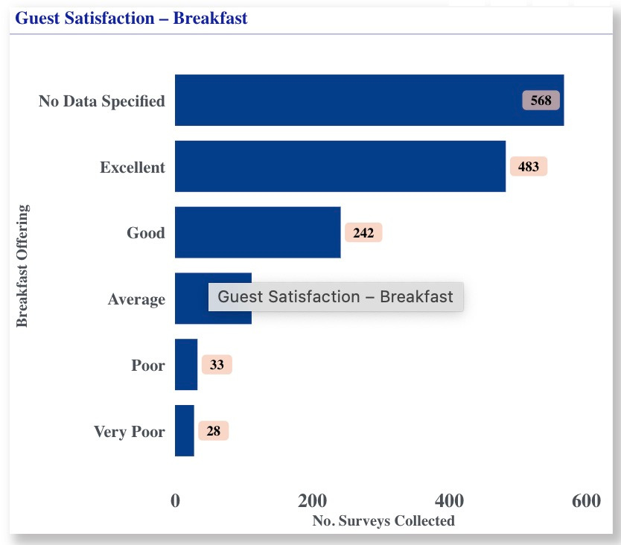
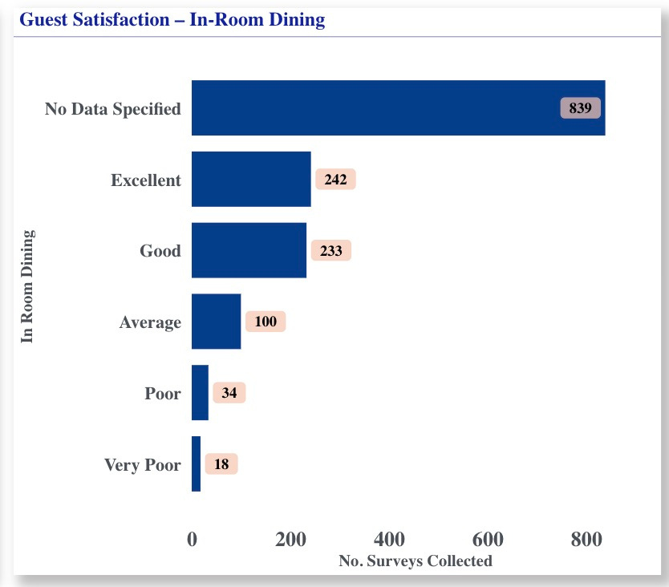
Performance & Trend Analysis
5) "Our breakfast offering"
6) "Our in-room dining"
Total number of Surveys for Breakfast Offering
Total number of Surveys for In-Room Dining

Slide 12
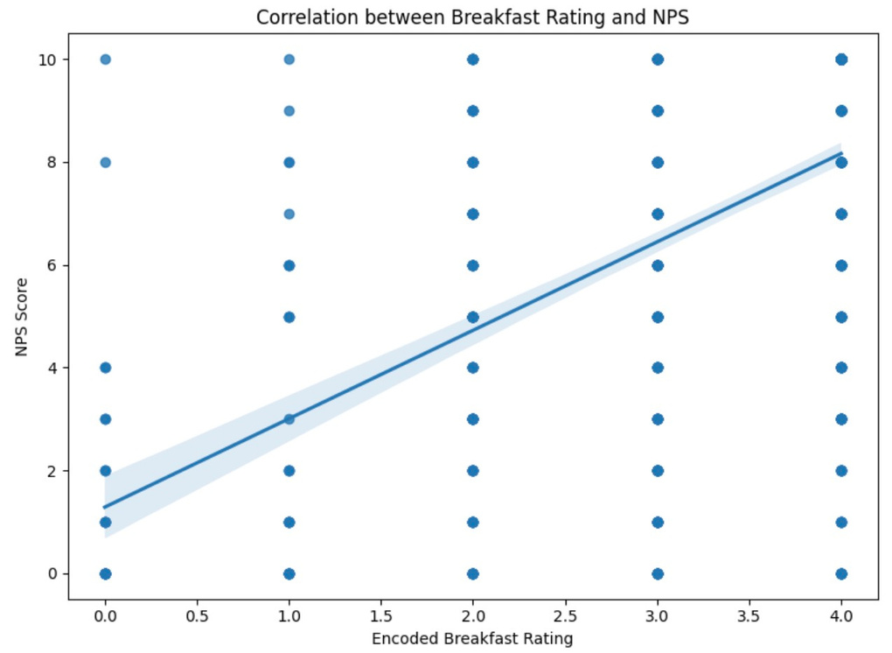
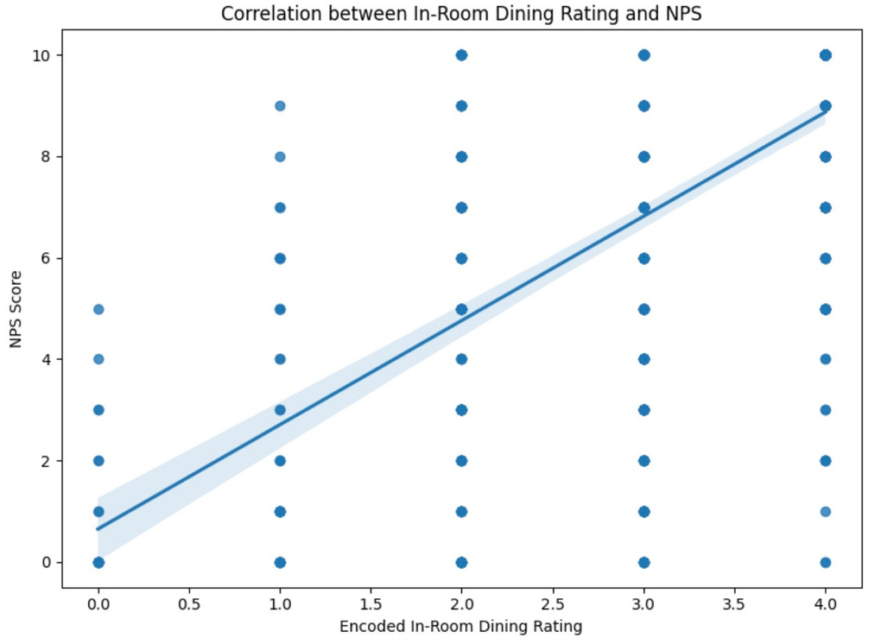
Insights
For "Our breakfast offering"
Internal Stakeholder - (Breakfast Outlet restaurant+ IRD(Brekkie offering))
Correlation coefficient is 0.523 between NPS and Breakfast Offering (encoded) signifies a moderate positive correlation.
For "Our in-room dining"
Internal Stakeholder - (Purely IRD - Chefs involved)
Correlation coefficient is 0.611 between NPS and In-Room Dining (encoded) signifies a strong positive correlation.

Slide 13
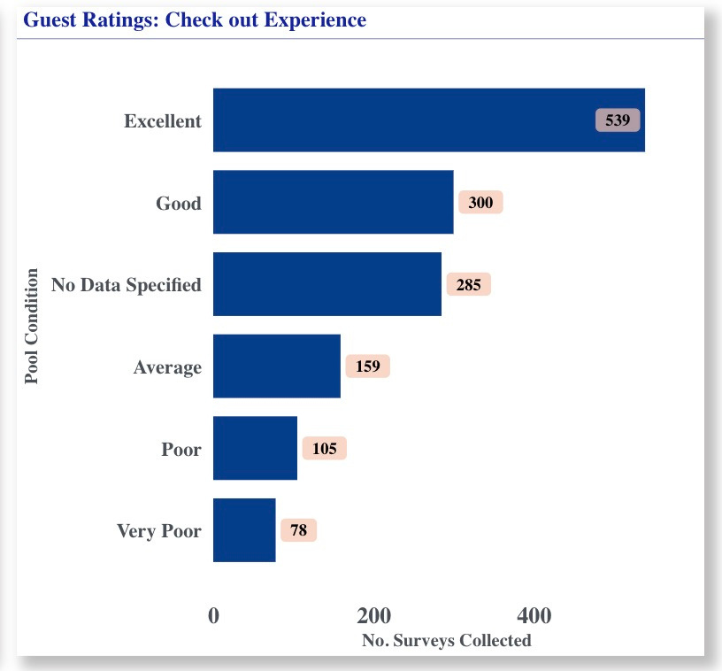
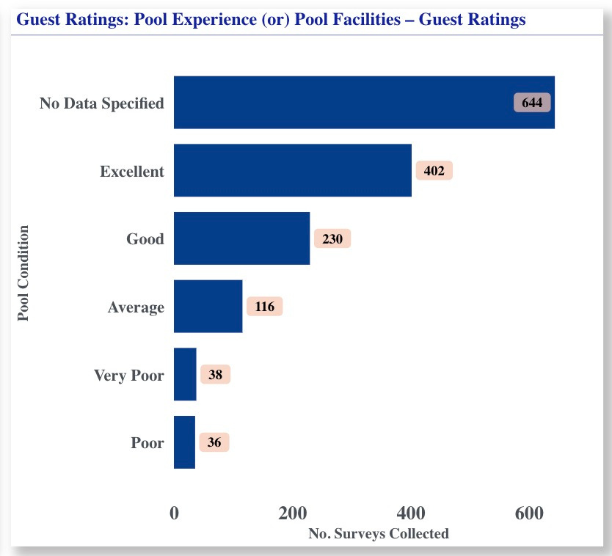
Performance & Trend Analysis
7) "Your check-out and departure experience"
8) "The pool experience"
Total number of Surveys for C/O experience
Total number of Surveys for Pool experience

Slide 14
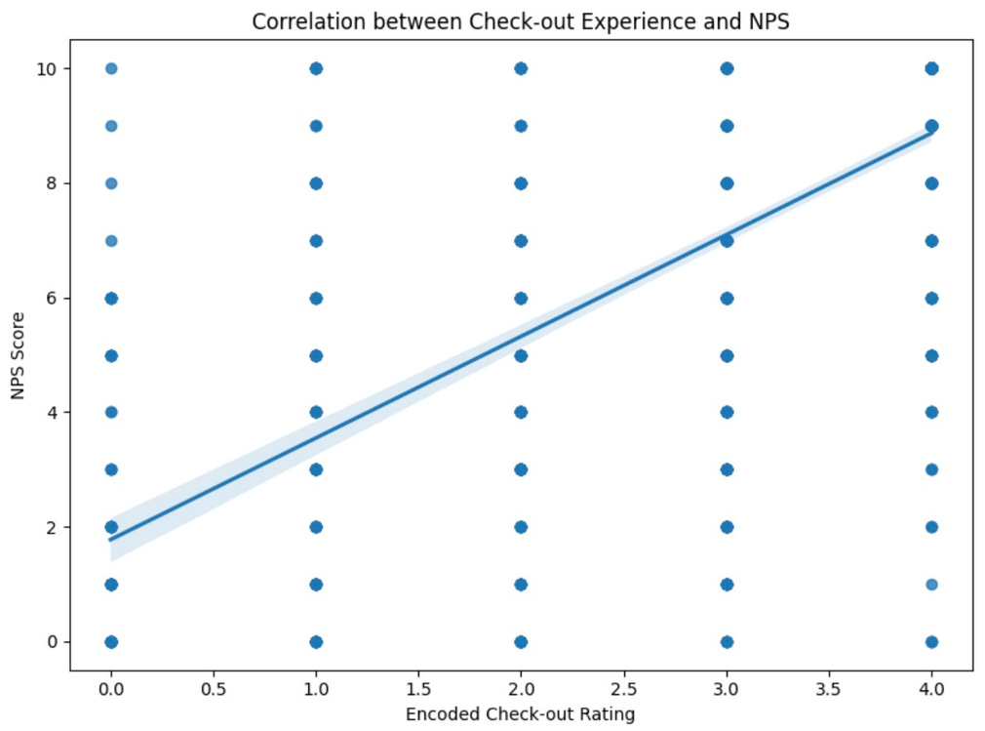

Insights
For "Your check-out and departure experience"
Internal Stakeholder - (Front Office ( Front Desk + Bell + Concierge))
Correlation coefficient is 0.67 between NPS and Check-out Experience (encoded) signifies a strong positive correlation.
For "The pool experience"
Internal Stakeholder - (Recreation Department)
Correlation coefficient is 0.610 between NPS and Pool Experience (encoded) signifies a strong positive correlation.

Slide 15
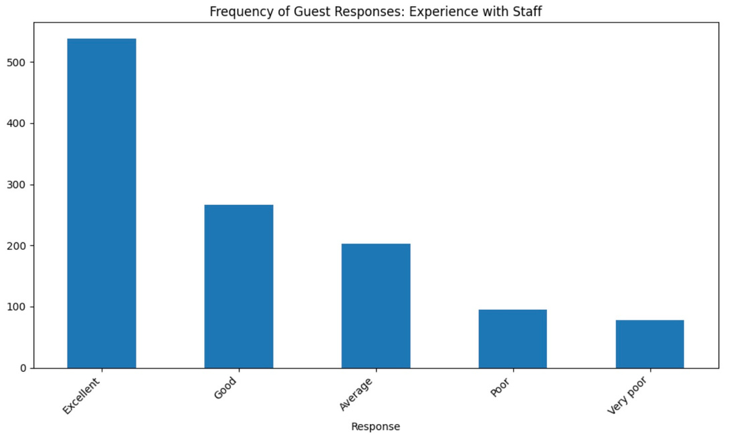
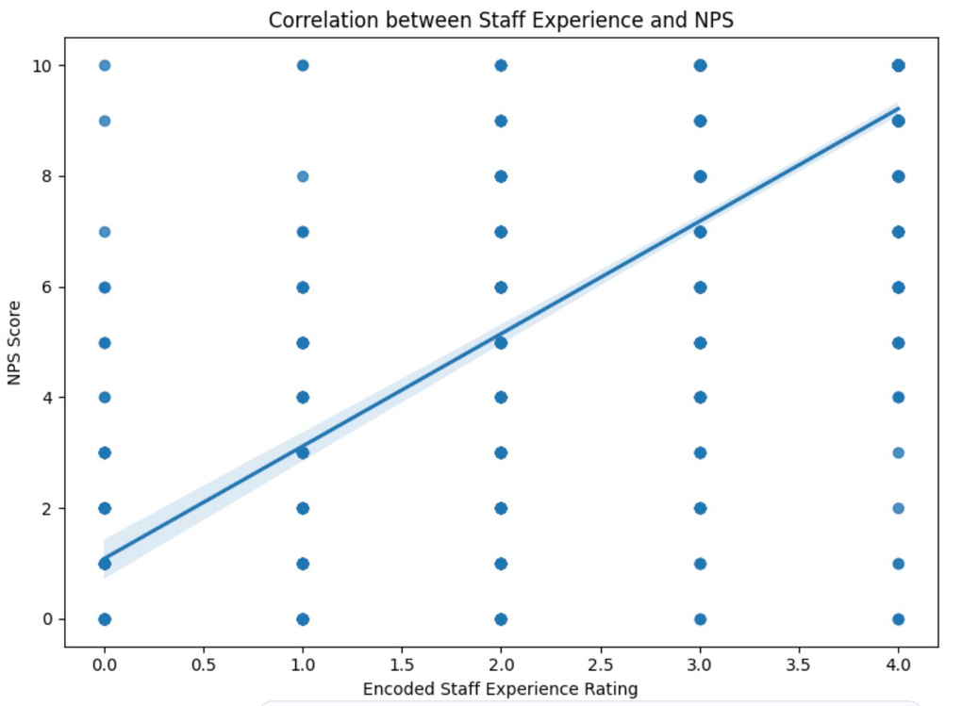
Performance & Trend Analysis + Insight
9) "Your experience with our people"
For "Your experience with our people"
Internal Stakeholder - [Individual Staff(Mainly focuses on Learning & Development, People&Culture, HR, On-boarding, Training & Development]
Correlation coefficient is 0.769 between NPS and Staff Experience (encoded) signifies a very strong positive correlation.
Total number of Surveys for experience with staff/our people

Slide 16
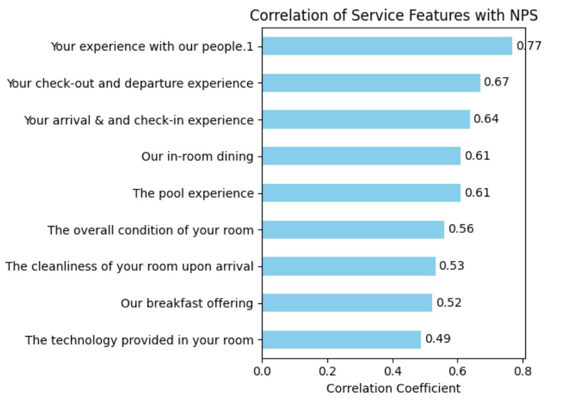
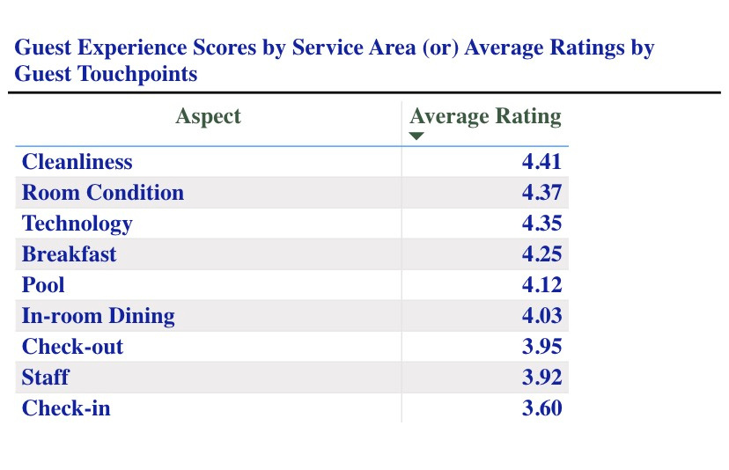
What is working well? & Key areas to focus on to improve NPS
Correlation Coefficients ranked from high to low
Current GX Scores across Individual Service Areas

Slide 17
Key areas to focus on to improve NPS
Staff Interaction has the highest correlation with NPS. But are one of the essential items to be focussed due to least scores. Top-priority area - Investing in staff training, recognition and Guest interactions can yield wonderful results. HR, L&D, Quality & Training can take measures to enhance the training benchmark.
.Check out / Departure Experience is one of the strongest final touch point and has the highest correlation after Staff experience, but current GX scores are a bit low. Hence this is always statistically significant, also, final impression matters - smooth, efficient and pleasant departure improves Guest loyalty. E.g. start Express Checkout boxes, more staffing across busy periods.
Check in / Arrival experience is under poor performance reaching an average range across 4 months. Since it has a moderately strong correlation with NPS, needs to have a increase in quality service delivery. E.g. Start Express Check-in for VIPs and Regular Guests, more staffing across busy periods.
Pool & Dining Experience are popular satisfaction elements.
Room Cleanliness and Overall Room Condition are performing well over 4 months providing great results. Keeping up the same work, will end up yielding good results due to their moderate positive correlation with NPS.

Slide 18
Recommendations
Two-way Data linking to improve GX, wherein cross-referencing and intergrating Guest Survey(External Feedback) with internal operational data. E.g. Valet, HSK, IRD and their respective valet logs, HSK shift audit logs and kitchen logs can be tagged to Guest responses via Surveys to improve process.
.Streamlining Processes with extra staffing. E.g. Lobby Ambassadors, Express C/O, C/I initiative.
We can leverage high performing internal stakeholders with the help of marketing team to gain more coverage or to shift focus. E.g. Marketing high performing restaurant outlet/chain to create more traffic, which in-turn uplifts other venues or services.
In terms of the Sample Data, Column “ What's the main reason you feel this way?” can be studied deeply using a technique called Natural Language Processing (NLP). Key themes and Sentiment analysis can be done on words in the sentences. E.g. “Great service”, “Room was dirty” - done through text pre-processing.

Slide 19




Tools and Technology
Excel was used to store Guest Survey Sample Data.
.Google Colab Notebook were used to run Python code instead of running it on the local machine. Also used Python for Data Processing, Analysis to gather insights.
Power BI was used to create a simple dashboard without any realtime data plugins. Dyanmic Dashboard to showcase graphs clearly.

Slide 20

Thank you!

